Slide 1
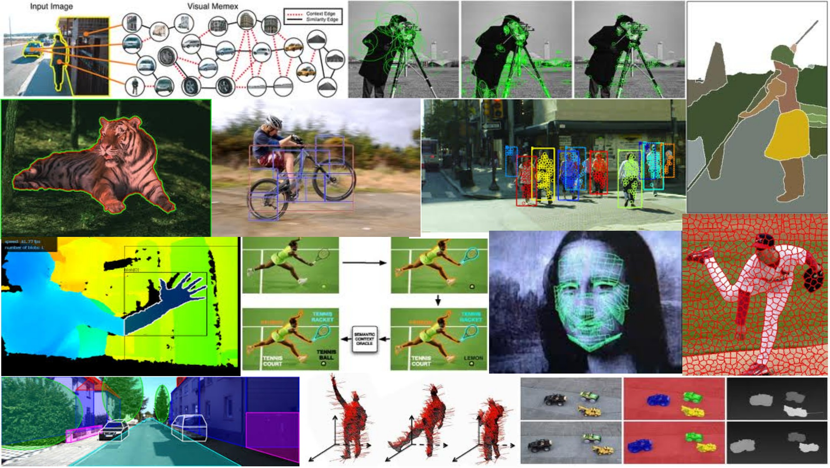
Segmentation and Grouping April 19th, 2018
Yong Jae Lee
UC Davis

Slide 2

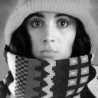

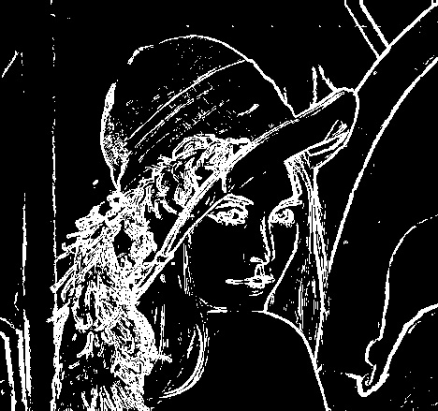
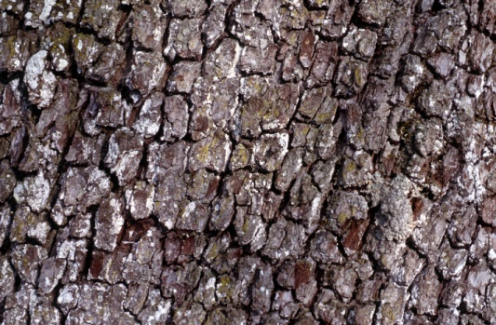
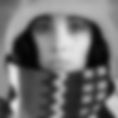
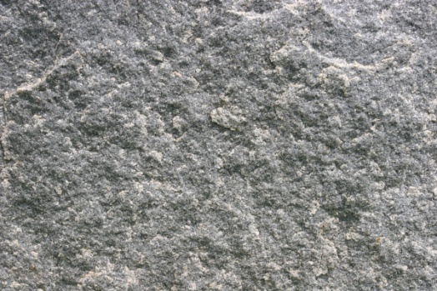
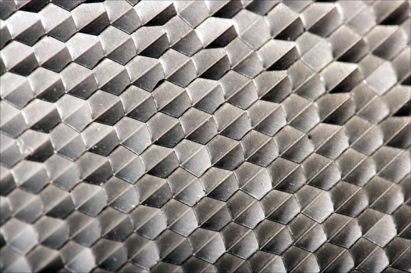
Features and filters
Transforming and describing images; textures, edges

Slide 3
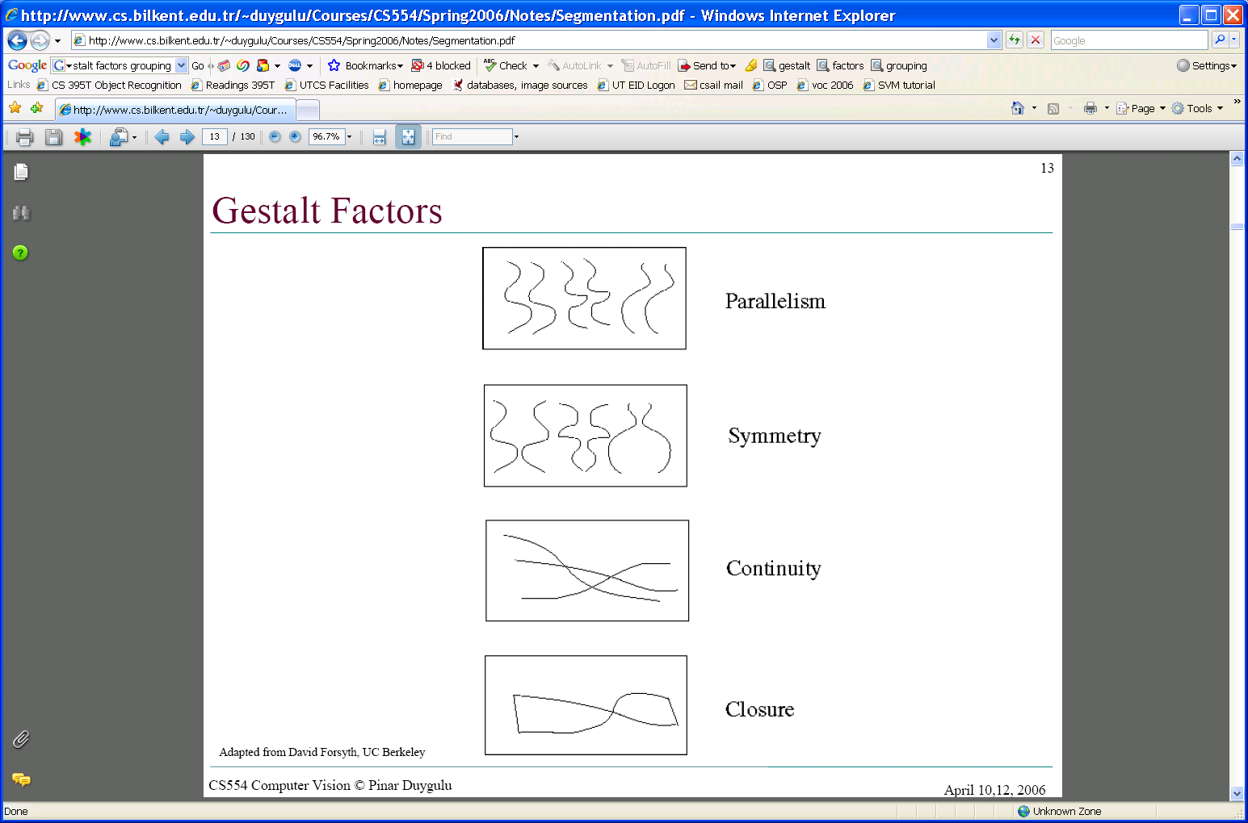
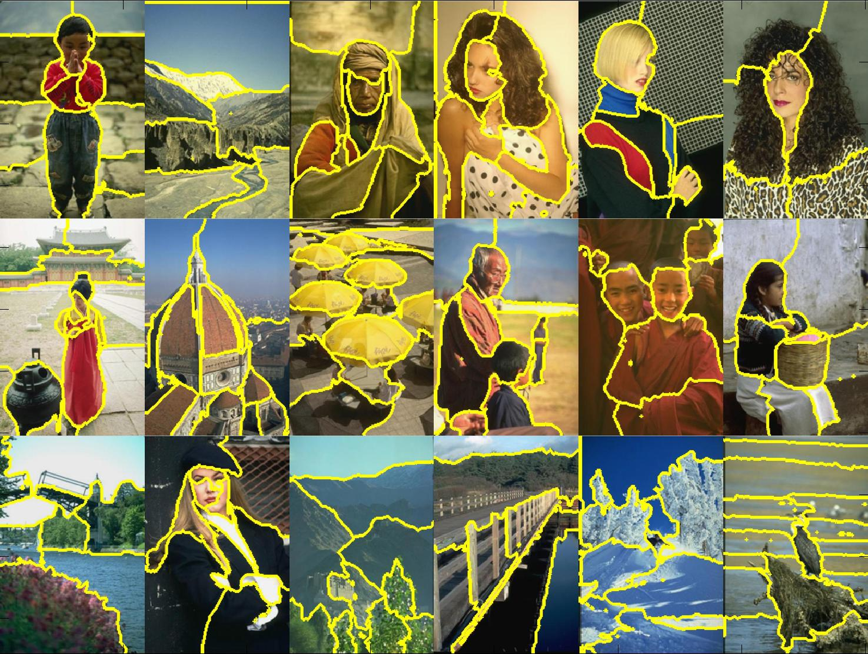
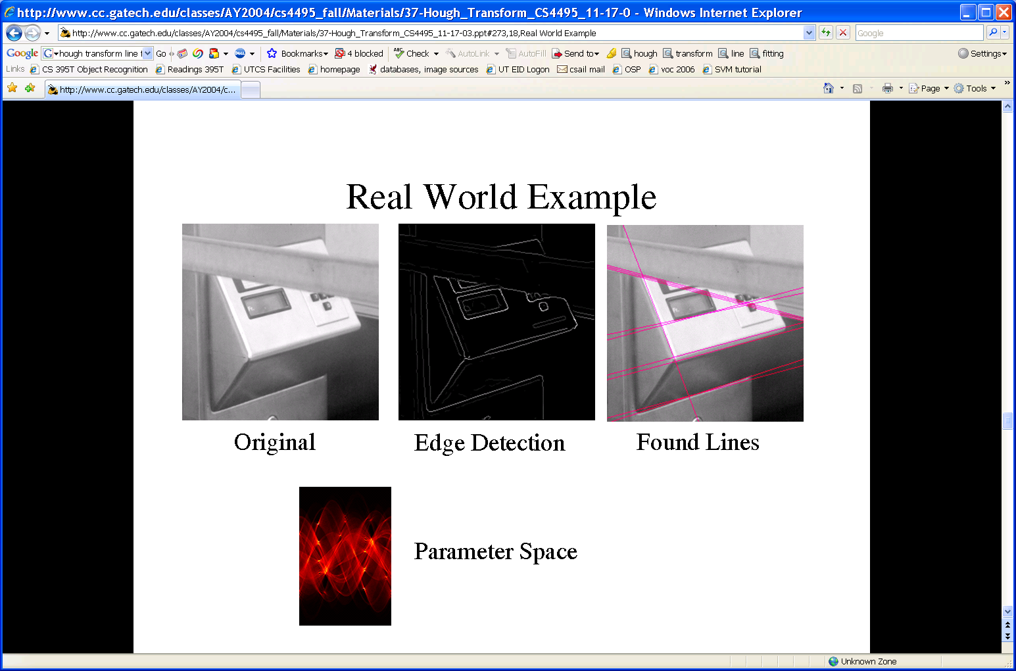
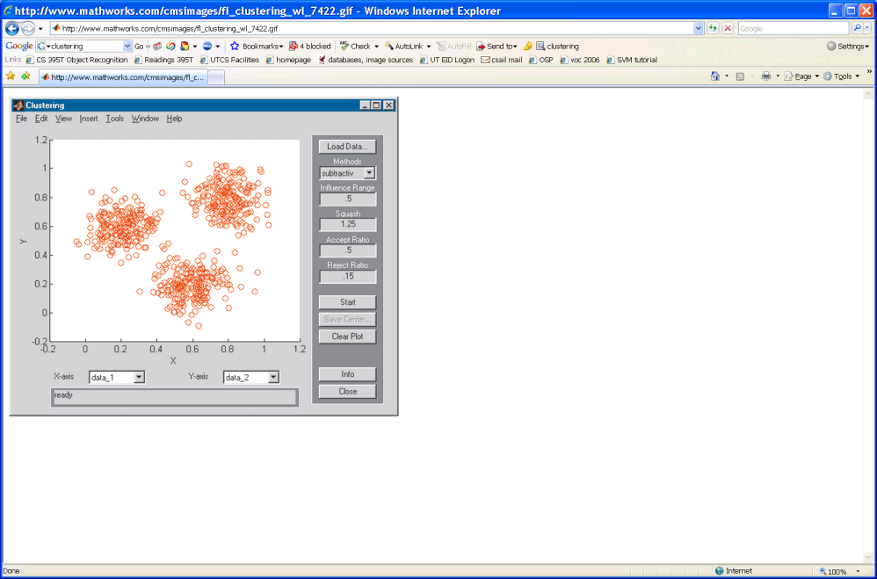
Grouping and fitting
Clustering, segmentation, fitting; what parts belong together?
[fig from Shi et al]

Slide 4
Outline
What are grouping problems in vision?
Inspiration from human perception
Gestalt properties
Bottom-up segmentation via clustering
Algorithms:
Mode finding and mean shift: k-means, mean-shift
Graph-based: normalized cuts
Features: color, texture, …
Quantization for texture summaries
Slide credit: Kristen Grauman
Notes:
4

Slide 5
Grouping in vision
Goals:
Gather features that belong together
Obtain an intermediate representation that compactly describes key image or video parts
Slide credit: Kristen Grauman
Notes:
An important component of vision involves organizing image information into meaningful assemblies.

Slide 6
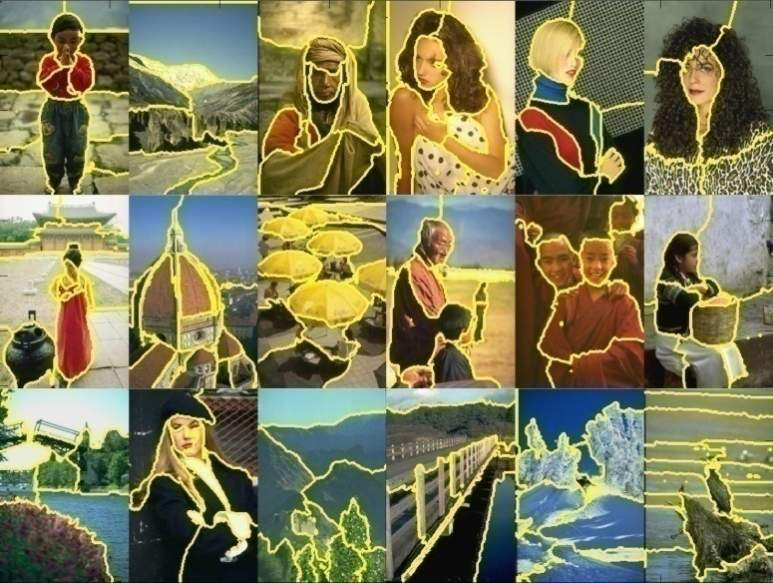
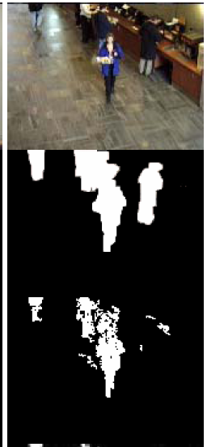
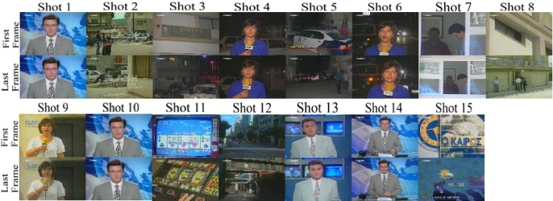
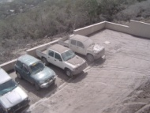
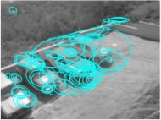
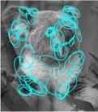
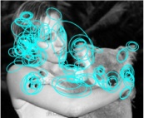
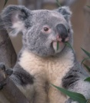
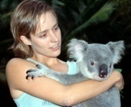
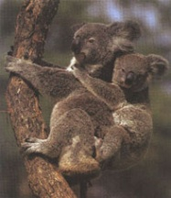
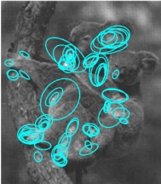
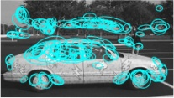
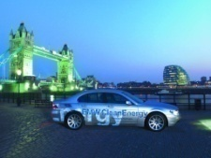
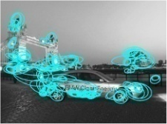



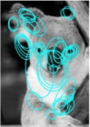
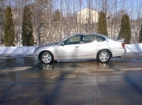
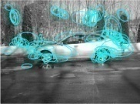
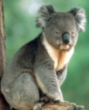
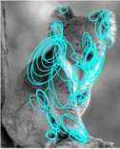
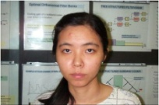
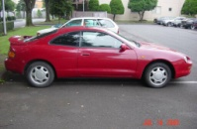
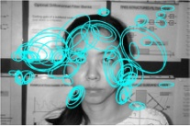
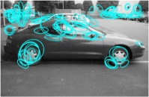
Examples of grouping in vision
[http://poseidon.csd.auth.gr/LAB_RESEARCH/Latest/imgs/SpeakDepVidIndex_img2.jpg]
Group video frames into shots
[Figure by J. Shi]
Determine image regions
[Figure by Wang & Suter]
Figure-ground
[Figure by Grauman & Darrell]
Object-level grouping
Slide credit: Kristen Grauman
Notes:
6

Slide 7
Grouping in vision
Goals:
Gather features that belong together
Obtain an intermediate representation that compactly describes key image (video) parts
Top down vs. bottom up segmentation
Top down: pixels belong together because they are from the same object
Bottom up: pixels belong together because they look similar
Hard to measure success
What is interesting depends on the app.
Slide credit: Kristen Grauman

Slide 8
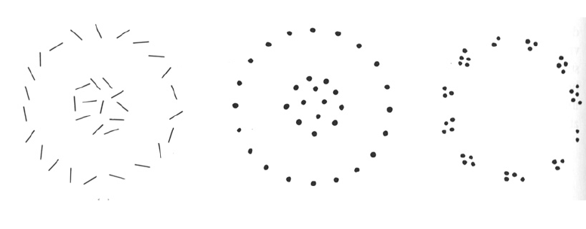
Slide credit: Kristen Grauman

Slide 9
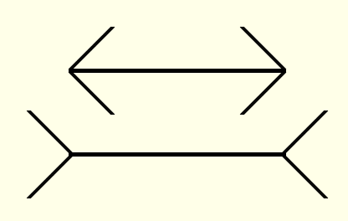
Muller-Lyer illusion
Slide credit: Kristen Grauman
Notes:
9
One hypothesis: "angles in“ usually corresponds to an object which is closer, and "angles out" usually corresponds to an object which is far away

Slide 10
Muller-Lyer illusion
Slide credit: Devi Parikh
Notes:
10

Slide 11
Muller-Lyer illusion
Slide credit: Devi Parikh
Notes:
11

Slide 12
Muller-Lyer illusion
Slide credit: Devi Parikh
Notes:
12

Slide 13
What things should be grouped? What cues indicate groups?

Slide 14
Gestalt
Gestalt: whole or group
Whole is greater than sum of its parts
Relationships among parts can yield new properties/features
Psychologists identified series of factors that predispose a set of elements to be grouped (by human visual system)
Slide credit: Kristen Grauman
Notes:
14
A movement in psychology founded in Germany in 1912, seeking to explain perceptions in terms of gestalts rather than by analyzing their constituents

Slide 15
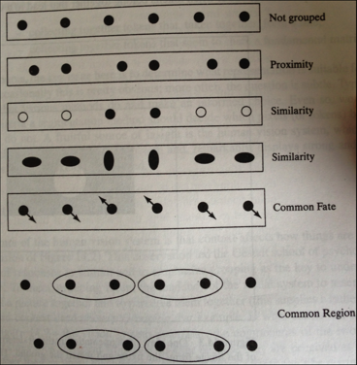
Gestalt
Figure 14.4 from Forsyth and Ponce

Slide 16
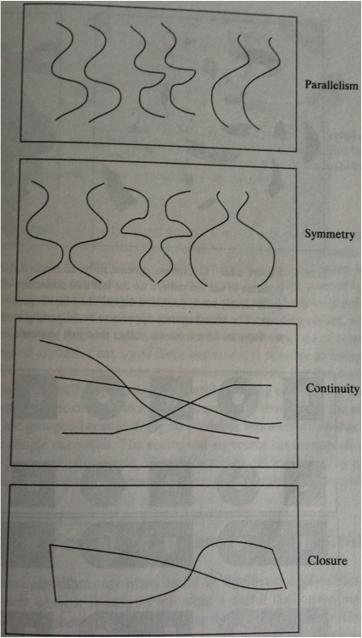
Gestalt
Slide credit: Devi Parikh

Slide 17
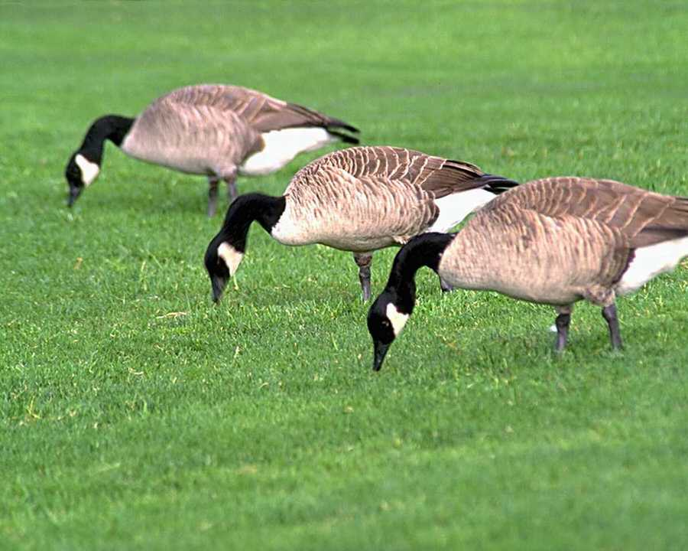
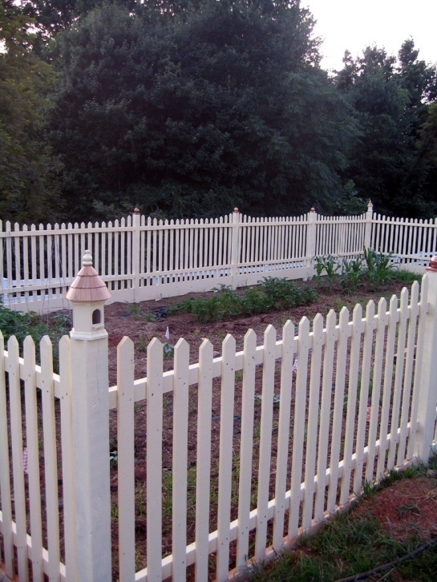
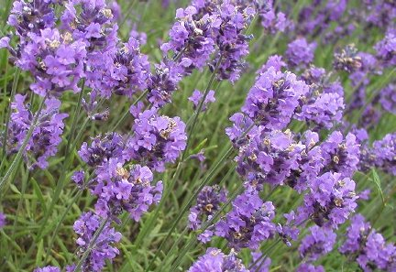
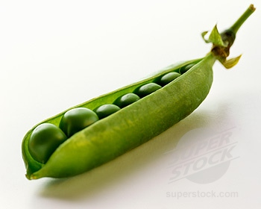
Similarity
Kristen Grauman
http://chicagoist.com/attachments/chicagoist_alicia/GEESE.jpg, http://wwwdelivery.superstock.com/WI/223/1532/PreviewComp/SuperStock_1532R-0831.jpg

Slide 18
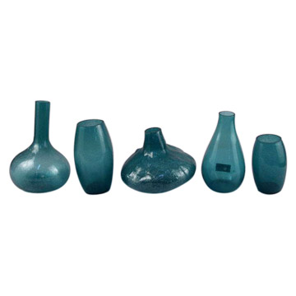
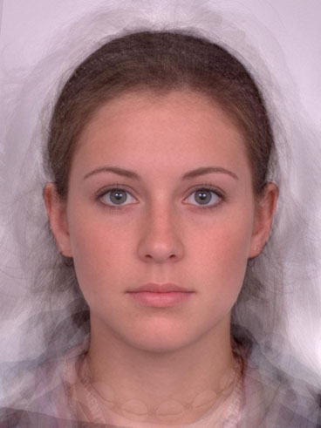
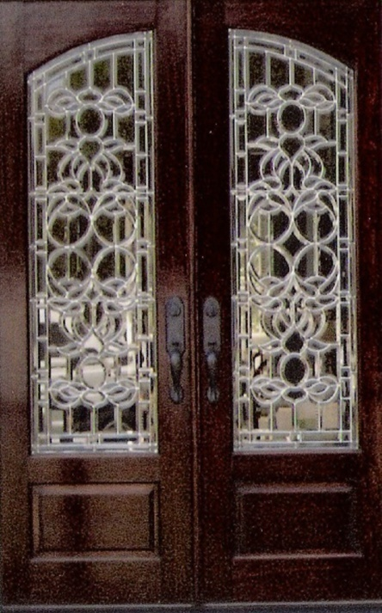
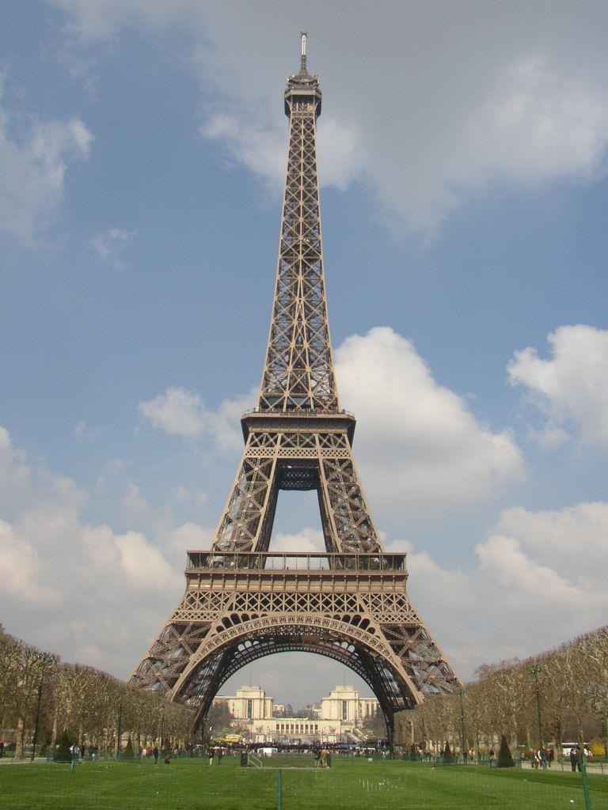
Symmetry
Slide credit: Kristen Grauman
http://seedmagazine.com/news/2006/10/beauty_is_in_the_processingtim.php

Slide 19
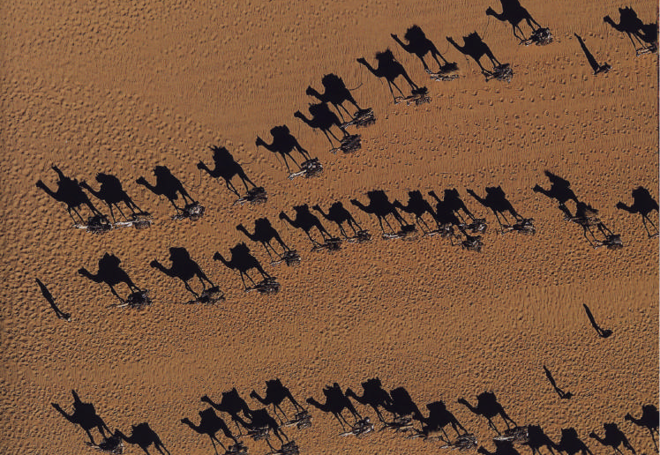
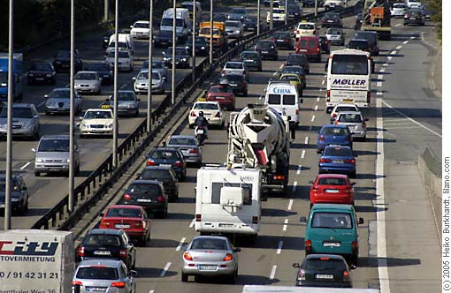
Common fate
Image credit: Arthus-Bertrand (via F. Durand)
Slide credit: Kristen Grauman

Slide 20
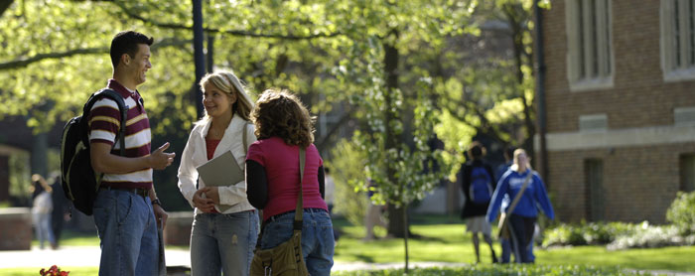
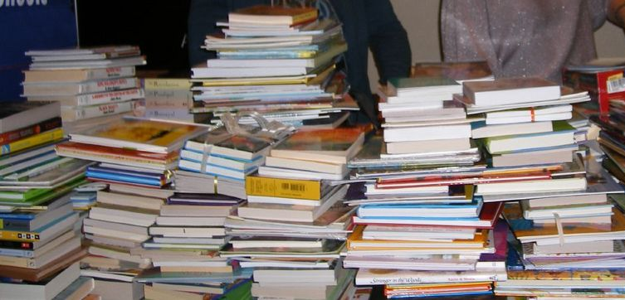
Proximity
Slide credit: Kristen Grauman
http://www.capital.edu/Resources/Images/outside6_035.jpg

Slide 21

Illusory contours
Interesting tendency to explain by occlusion
In Vision, D. Marr, 1982
Notes:
21

Slide 22

Slide credit: Kristen Grauman

Slide 23

Continuity, explanation by occlusion
Slide credit: Kristen Grauman

Slide 24

D. Forsyth

Slide 25

D. Forsyth

Slide 26

Figure-ground
D. Forsyth
Notes:
Profile/vase

Slide 27

D. Forsyth
Notes:
27

Slide 28

Grouping phenomena in real life
Forsyth & Ponce, Figure 14.7
Slide credit: Kristen Grauman
Notes:
elevator

Slide 29
Grouping phenomena in real life
Forsyth & Ponce, Figure 14.7
Slide credit: Kristen Grauman
Notes:
Proximity cue disambiguated

Slide 30
Gestalt
Gestalt: whole or group
Whole is greater than sum of its parts
Relationships among parts can yield new properties/features
Psychologists identified series of factors that predispose set of elements to be grouped (by human visual system)
Inspiring observations/explanations; challenge remains how to best map to algorithms.
Slide credit: Kristen Grauman
Notes:
30

Slide 31
Outline
What are grouping problems in vision?
Inspiration from human perception
Gestalt properties
Bottom-up segmentation via clustering
Algorithms:
Mode finding and mean shift: k-means, mean-shift
Graph-based: normalized cuts
Features: color, texture, …
Quantization for texture summaries
Slide credit: Kristen Grauman
Notes:
31

Slide 32




The goals of segmentation
Separate image into coherent “objects”
image
human segmentation
Source: Lana Lazebnik

Slide 33


The goals of segmentation
Separate image into coherent “objects”
Group together similar-looking pixels for efficiency of further processing
“superpixels”
X. Ren and J. Malik. Learning a classification model for segmentation. ICCV 2003.
Source: Lana Lazebnik

Slide 34


Image segmentation: toy example
white pixels
pixel count
3
black pixels
gray pixels
1
2
input image
intensity
These intensities define the three groups.
We could label every pixel in the image according to which of these primary intensities it is.
i.e., segment the image based on the intensity feature.
What if the image isn’t quite so simple?
Kristen Grauman

Slide 35


pixel count
input image
intensity
pixel count
input image
intensity
Kristen Grauman

Slide 36
pixel count
input image
intensity
Now how to determine the three main intensities that define our groups?
We need to cluster.
Kristen Grauman

Slide 37

0
190
255
intensity
3
1
2
Goal: choose three “centers” as the representative intensities, and label every pixel according to which of these centers it is nearest to.
Best cluster centers are those that minimize SSD between all points and their nearest cluster center ci:
Kristen Grauman

Slide 38
Clustering
With this objective, it is a “chicken and egg” problem:
If we knew the cluster centers, we could allocate points to groups by assigning each to its closest center.
If we knew the group memberships, we could get the centers by computing the mean per group.
Kristen Grauman

Slide 39
K-means clustering
Basic idea: randomly initialize the k cluster centers, and iterate between the two steps we just saw.
Randomly initialize the cluster centers, c₁, ..., c_{K}
Given cluster centers, determine points in each cluster
For each point p, find the closest c_{i}. Put p into cluster i
Given points in each cluster, solve for c_{i}
Set c_{i} to be the mean of points in cluster i
If c_{i} have changed, repeat Step 2
Properties
Will always converge to some solution
Can be a “local minimum”
does not always find the global minimum of objective function:
Source: Steve Seitz

Slide 40

Andrew Moore

Slide 41

Andrew Moore

Slide 42

Andrew Moore

Slide 43

Andrew Moore

Slide 44

Andrew Moore

Slide 45
K-means clustering
Demo
http://home.dei.polimi.it/matteucc/Clustering/tutorial_html/AppletKM.html
Slide credit: Kristen Grauman

Slide 46


K-means: pros and cons
Pros
Simple, fast to compute
Converges to local minimum of within-cluster squared error
Cons/issues
Setting k?
Sensitive to initial centers
Sensitive to outliers
Detects spherical clusters
Slide credit: Kristen Grauman
Notes:
46

Slide 47

An aside: Smoothing out cluster assignments
Assigning a cluster label per pixel may yield outliers:
original
labeled by cluster center’s intensity
?
How to ensure they are spatially smooth?
3
1
2
Kristen Grauman

Slide 48

Segmentation as clustering
Depending on what we choose as the feature space, we can group pixels in different ways.
Grouping pixels based on intensity similarity
Feature space: intensity value (1-d)
Slide credit: Kristen Grauman
Notes:
48

Slide 49


K=2
K=3
quantization of the feature space; segmentation label map
Slide credit: Kristen Grauman

Slide 50

Segmentation as clustering
Depending on what we choose as the feature space, we can group pixels in different ways.
R=255
G=200
B=250
Grouping pixels based on color similarity
B
R=245
G=220
B=248
G
R=15
G=189
B=2
R=3
G=12
B=2
R
Feature space: color value (3-d)
Kristen Grauman
Notes:
50

Slide 51
Segmentation as clustering
Depending on what we choose as the feature space, we can group pixels in different ways.
Grouping pixels based on intensity similarity
Clusters based on intensity similarity don’t have to be spatially coherent.
Kristen Grauman
Notes:
51

Slide 52
Segmentation as clustering
Depending on what we choose as the feature space, we can group pixels in different ways.
Grouping pixels based on intensity+position similarity
Intensity
Y
X
Both regions are black, but if we also include position (x,y), then we could group the two into distinct segments; way to encode both similarity & proximity.
Kristen Grauman
Notes:
52

Slide 53



Segmentation as clustering
Color, brightness, position alone are not enough to distinguish all regions…
Slide credit: Kristen Grauman

Slide 54

Segmentation as clustering
Depending on what we choose as the feature space, we can group pixels in different ways.
Grouping pixels based on texture similarity
F₁
F₂
Filter bank of 24 filters
…
F₂₄
Feature space: filter bank responses (e.g., 24-d)
Slide credit: Kristen Grauman
Notes:
54

Slide 55

Recall: texture representation example
 | mean d/dx value | mean d/dy value
Win. #1 | 4 | 10
Win.#2 | 18 | 7
Win.#9 | 20 | 20
original image
…
…
statistics to summarize patterns in small windows
derivative filter responses, squared
Slide credit: Kristen Grauman

Slide 56
Recall: texture representation example
Windows with primarily horizontal edges
Both
 | mean d/dx value | mean d/dy value
Win. #1 | 4 | 10
Win.#2 | 18 | 7
Win.#9 | 20 | 20
Dimension 2 (mean d/dy value)
Dimension 1 (mean d/dx value)
…
…
Windows with small gradient in both directions
Windows with primarily vertical edges
statistics to summarize patterns in small windows
Kristen Grauman
Notes:
56

Slide 57


Segmentation with texture features
Find “textons” by clustering vectors of filter bank outputs
Describe texture in a window based on texton histogram
Count
Image
Texton map
Texton index
Count
Count
Texton index
Texton index
Malik, Belongie, Leung and Shi. IJCV 2001.

Slide 58

Image segmentation example
Kristen Grauman

Slide 59


Color vs. texture
These look very similar in terms of their color distributions (histograms).
How would their texture distributions compare?
Kristen Grauman

Slide 60

Material classification example
For an image of a single texture, we can classify it according to its global (image-wide) texton histogram.
Figure from Varma & Zisserman, IJCV 2005

Slide 61


Material classification example
Nearest neighbor classification: label the input according to the nearest known example’s label.
Manik Varma
http://www.robots.ox.ac.uk/~vgg/research/texclass/with.html
Slide credit: Kristen Grauman

Slide 62
Outline
What are grouping problems in vision?
Inspiration from human perception
Gestalt properties
Bottom-up segmentation via clustering
Algorithms:
Mode finding and mean shift: k-means, mean-shift
Graph-based: normalized cuts
Features: color, texture, …
Quantization for texture summaries
Slide credit: Kristen Grauman
Notes:
62

Slide 63
K-means: pros and cons
Pros
Simple, fast to compute
Converges to local minimum of within-cluster squared error
Cons/issues
Setting k?
Sensitive to initial centers
Sensitive to outliers
Detects spherical clusters
Slide credit: Kristen Grauman
Notes:
63

Slide 64

Mean shift algorithm
The mean shift algorithm seeks modes or local maxima of density in the feature space
Feature space
(L*u*v* color values)
image
Slide credit: Kristen Grauman

Slide 65
Mean shift
Search window
Center of
mass
Mean Shift
vector
Slide by Y. Ukrainitz & B. Sarel

Slide 66
Mean shift
Search window
Center of
mass
Mean Shift
vector
Slide by Y. Ukrainitz & B. Sarel

Slide 67
Mean shift
Search window
Center of
mass
Mean Shift
vector
Slide by Y. Ukrainitz & B. Sarel

Slide 68
Mean shift
Search window
Center of
mass
Mean Shift
vector
Slide by Y. Ukrainitz & B. Sarel

Slide 69
Mean shift
Search window
Center of
mass
Mean Shift
vector
Slide by Y. Ukrainitz & B. Sarel

Slide 70
Mean shift
Search window
Center of
mass
Mean Shift
vector
Slide by Y. Ukrainitz & B. Sarel

Slide 71
Mean shift
Search window
Center of
mass
Slide by Y. Ukrainitz & B. Sarel

Slide 72

Mean shift clustering
Cluster: all data points in the attraction basin of a mode
Attraction basin: the region for which all trajectories lead to the same mode
Slide by Y. Ukrainitz & B. Sarel

Slide 73

Mean shift clustering/segmentation
Find features (color, gradients, texture, etc)
Initialize windows at individual feature points
Perform mean shift for each window until convergence
Merge windows that end up near the same “peak” or mode
Slide credit: Kristen Grauman

Slide 74

Mean shift segmentation results
Slide credit: Kristen Grauman

Slide 75
Mean shift
Pros:
Does not assume shape on clusters
One parameter choice (window size)
Generic technique
Find multiple modes
Cons:
Selection of window size
Does not scale well with dimension of feature space
Kristen Grauman

Slide 76
Outline
What are grouping problems in vision?
Inspiration from human perception
Gestalt properties
Bottom-up segmentation via clustering
Algorithms:
Mode finding and mean shift: k-means, mean-shift
Graph-based: normalized cuts
Features: color, texture, …
Quantization for texture summaries
Slide credit: Kristen Grauman
Notes:
76

Slide 77

Images as graphs
q
w_{pq}
w
p
Fully-connected graph
node (vertex) for every pixel
link between every pair of pixels, p,q
affinity weight w_{pq} for each link (edge)
w_{pq} measures similarity
similarity is inversely proportional to difference (in color and position…)
Source: Steve Seitz

Slide 78


Measuring affinity
One possibility:
Small sigma: group only nearby points
Large sigma: group distant points
Kristen Grauman
Notes:
Gaussian kernel

Slide 79

Measuring affinity
σ=.2
Data points
Affinity matrices
σ=.1 σ=.2 σ=1
Slide credit: Kristen Grauman

Slide 80
Segmentation by Graph Cuts
q
w_{pq}
w
p
A
B
C
Break Graph into Segments
Want to delete links that cross between segments
Easiest to break links that have low similarity (low weight)
similar pixels should be in the same segments
dissimilar pixels should be in different segments
Source: Steve Seitz

Slide 81
Cuts in a graph: Min cut
B
A
Link Cut
set of links whose removal makes a graph disconnected
cost of a cut:
Find minimum cut
gives you a segmentation
fast algorithms exist for doing this
Source: Steve Seitz

Slide 82

Minimum cut
Problem with minimum cut:
Weight of cut proportional to number of edges in the cut; tends to produce small, isolated components.
[Shi & Malik, 2000 PAMI]
Slide credit: Kristen Grauman

Slide 83

Cuts in a graph: Normalized cut
B
A
Normalized Cut
fix bias of Min Cut by normalizing for size of segments:
assoc(A,V) = sum of weights of all edges in A to all nodes V
Ncut value small when we get two clusters with many edges with high weights, and few edges of low weight between them
Approximate solution for minimizing the Ncut value: generalized eigenvalue problem.
J. Shi and J. Malik, Normalized Cuts and Image Segmentation, CVPR, 1997
Source: Steve Seitz
Notes:
Want cut(A,B) to be small and assoc(A,V), assoc(B,V) to be big – assoc can be thought of as size of cluster.

Slide 84









Example results
Slide credit: Kristen Grauman
Notes:
Color + position

Slide 85
Normalized cuts: pros and cons
Pros:
Generic framework, flexible to choice of function that computes weights (“affinities”) between nodes
Does not require model of the data distribution
Cons:
Time complexity can be high
Dense, highly connected graphs → many affinity computations
Solving eigenvalue problem
Preference for balanced partitions
Kristen Grauman

Slide 86




Segmentation for efficiency: “superpixels”
[Felzenszwalb and Huttenlocher 2004]
[Shi and Malik 2001]
[Hoiem et al. 2005, Mori 2005]

Slide 87

Segmentation for object proposals
“Selective Search” [Sande, Uijlings et al. ICCV 2011, IJCV 2013]
[Endres Hoiem ECCV 2010, IJCV 2014]

Slide 88






Motion segmentation
Input sequence
Image Segmentation
Motion Segmentation
Input sequence
Image Segmentation
Motion Segmentation
Barbu, S.C. Zhu. Generalizing Swendsen-Wang to sampling arbitrary posterior probabilities, IEEE Trans. PAMI, August 2005.
Kristen Grauman

Slide 89
Summary
Segmentation to find object boundaries or mid-level regions, tokens.
Bottom-up segmentation via clustering
General choices -- features, affinity functions, and clustering algorithms
Grouping also useful for quantization, can create new feature summaries
Texton histograms for texture within local region
Example clustering methods
K-means
Mean shift
Graph cut, normalized cuts
Slide credit: Kristen Grauman

Slide 90
Questions?
See you Tuesday!

